Slide 1
Information about HIV Prevention Options
MTN-025 (HOPE Study)
Community Education Presentation

Slide 2
Options for HIV Prevention
There are many things you can do to reduce your or your partner’s risk of HIV.
Counsellors want to help you understand all of the following options for HIV prevention so you can choose which method(s) will work best for you:

Slide 3
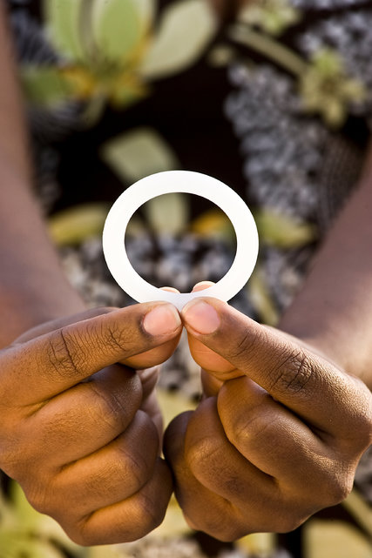
Studies have shown the dapivirine vaginal ring can reduce a women’s chance of HIV infection. Protection from HIV infection is highest when the ring is used all the time.
Use the dapivirine vaginal ring consistently

Slide 4
Use condoms consistently
Use a condom correctly every time you have vaginal, anal, or oral sex.
Notes:
See the back of this pamphlet for more information about condoms.

Slide 5
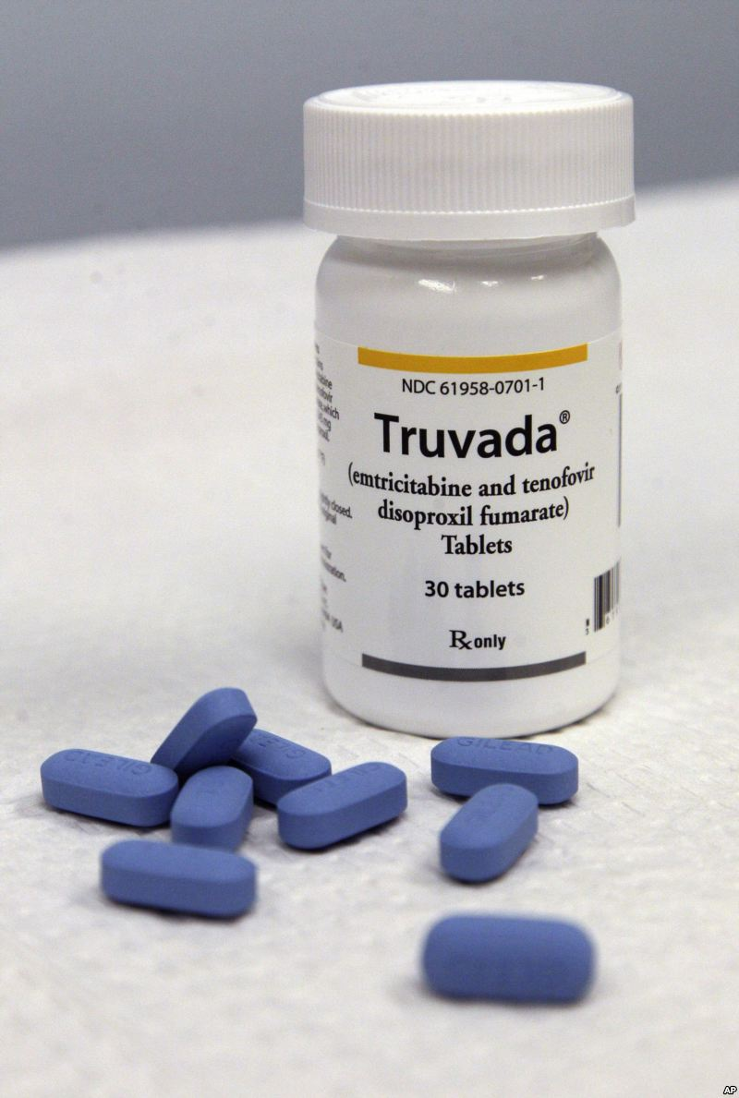
Use oral PrEP (e.g. Truvada)
Oral PrEP is an HIV prevention option for people who don’t have HIV but who are at high risk of becoming infected with HIV.
Oral PrEP involves taking a specific HIV medicine every day.
Oral PrEP may or may not be available in your community.
Notes:
If it sounds like an option you would like to use, talk to the clinic staff about whether it is available locally.

Slide 6
Reduce your number of sex partners
Notes:
The more partners you have, the more likely you are to have a partner with HIV. If your partner has multiple partners, encourage them to reduce this number as well. It will decrease the risk of acquiring HIV for all of you.

Slide 7
Engage in lower-risk sexual behaviors
Oral sex is much less risky than vaginal or anal sex. Many people think that anal sex is a safer option, but it is actually the most risky type of sex for HIV transmission.

Slide 8
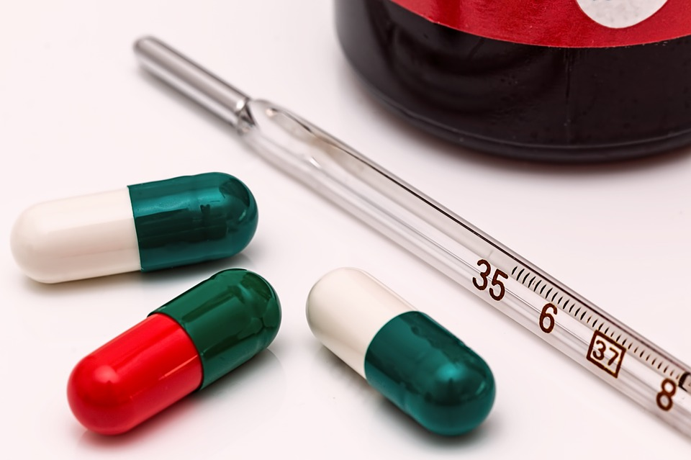
If you have a sexually transmitted infection (STI), get treatment
Having an STI can increase your risk of becoming infected with HIV or spreading it to others. Insist that your partners get tested and treated too.

Slide 9
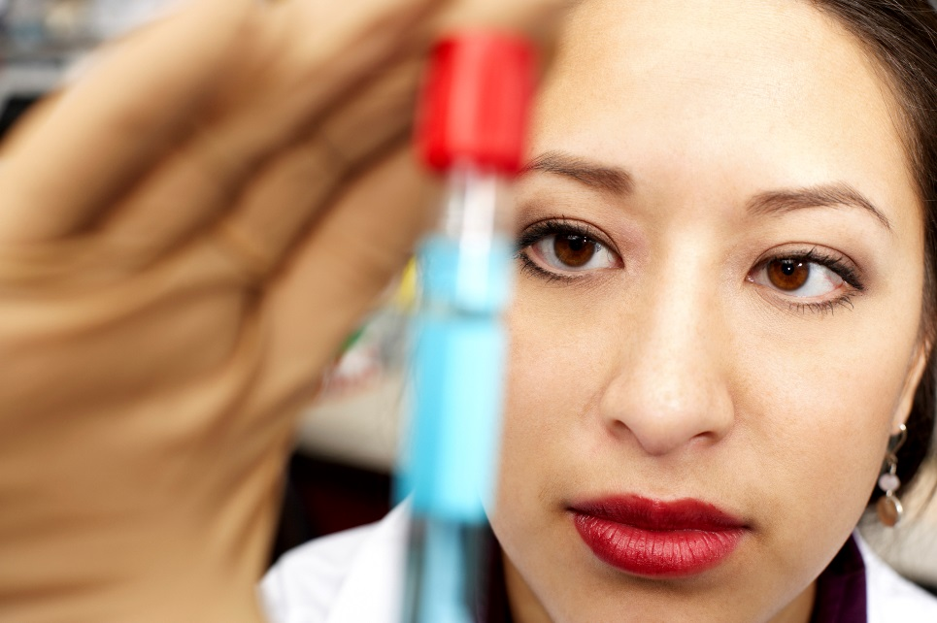
Encourage your partner to get
tested for HIV
Talk to your partner about HIV testing and get tested before you have sex.
Knowing if your partner is HIV positive can help you decide which prevention methods might be most effective for you.

Slide 10
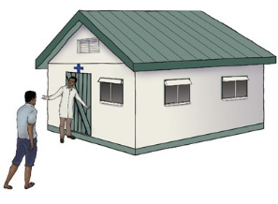
Encourage your partner to
get circumcised
Men who are circumcised are about half as likely to get HIV as men who are not circumcised.
Male circumcision does not protect women from getting HIV.

Slide 11
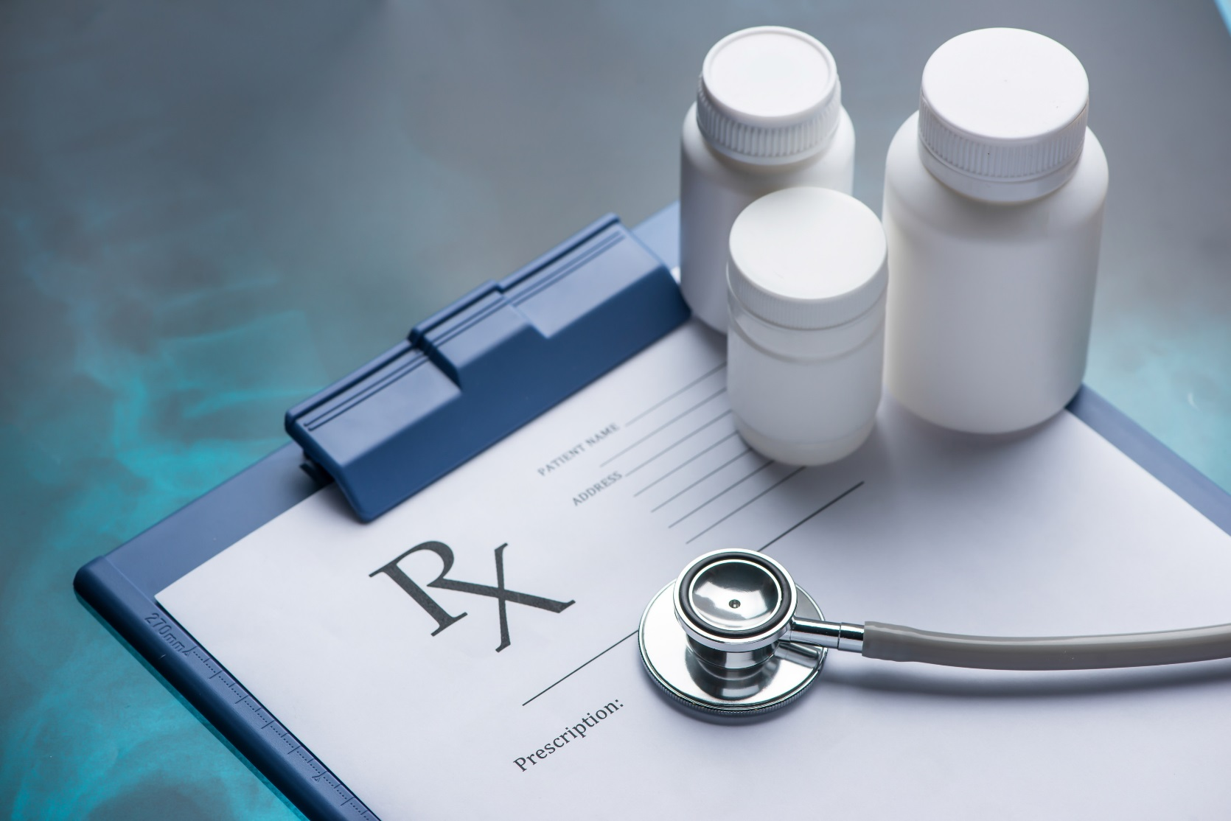
If your partner is HIV positive, encourage them to be adherent to their HIV medications
Notes:
Treatment with HIV medicines (called antiretroviral therapy or ART for short) helps people with HIV live longer, healthier lives. ART can’t cure HIV infection, but it can reduce the amount of HIV in the body. Having less HIV in the body reduces the risk of your partner passing HIV during sex.

Slide 12
Although all options may not be possible for all women, the more of these things you can do, the more you reduce your chance of getting HIV.

Slide 13
Additional information about condoms
Condoms protect against HIV infection from vaginal and anal sex.
The dapivirine ring reduces the risk of HIV acquired through vaginal sex.
The ring was not designed to protect from HIV transmission through anal sex and should never be used rectally.

Slide 14
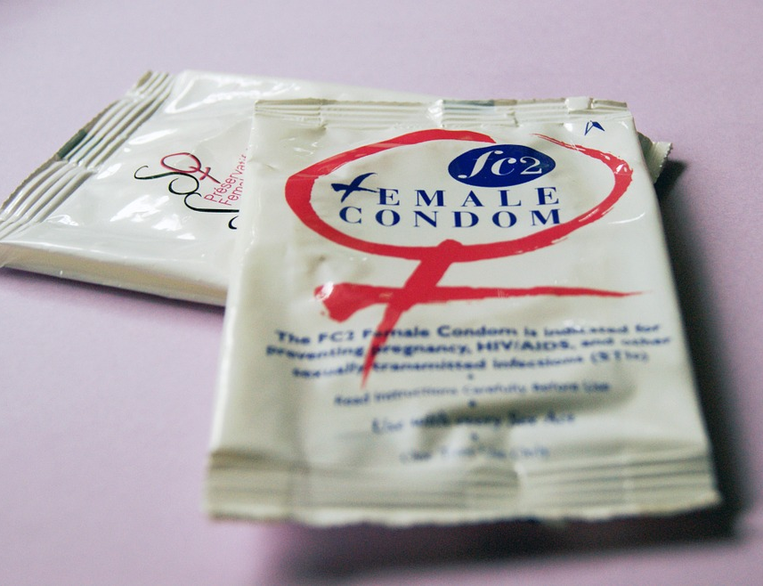
Additional information about condoms
Condoms Protect Against Pregnancy and Other STIs.
When used consistently and correctly, latex condoms are the best way to protect against other STIs such as gonorrhoea, chlamydia, or trichomonas.
Notes:
In addition to protecting against HIV, condoms have other health benefits.
Some couples choose condoms as their family planning method to prevent unintended pregnancies.
They also reduce the risk for genital ulcer diseases, such as genital herpes, syphilis, and chancroid, when the infected area or site of potential exposure is protected. They may reduce the risk for genital human papillomavirus (HPV) infection and HPV-associated diseases (e.g., genital warts and cervical cancer).

Slide 15
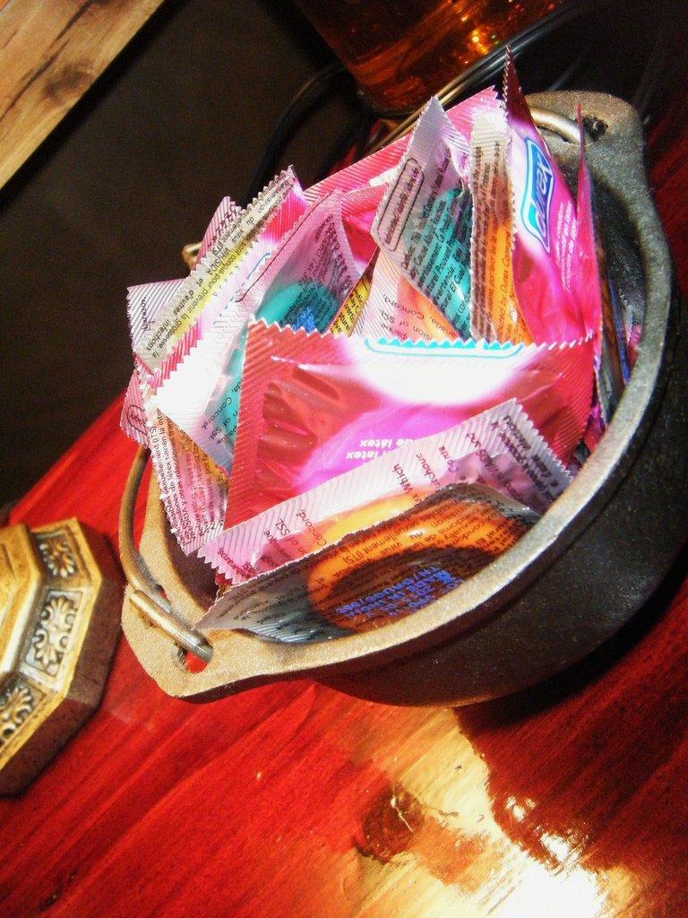
How to Correctly and Consistently Use Condoms
Use a new condom with each sex act (oral, vaginal, and anal).

Slide 16
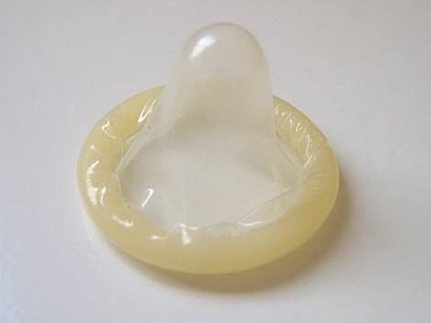
How to Correctly and Consistently Use Condoms
Carefully handle the condom to avoid damaging it with fingernails, teeth, or other sharp objects.
Put the condom on after the penis is erect and before any genital, oral, or anal contact with the partner.

Slide 17
How to Correctly and Consistently Use Condoms
Ensure adequate lubrication during vaginal and anal sex, but use only water-based lubricants (like K-Y Jelly) with latex condoms.
Oil-based lubricants (like Vaseline or body lotion) will damage condoms.

Slide 18
How to Correctly and Consistently Use Condoms
To prevent the condom from slipping off, hold the condom firmly against the base of the penis during withdrawal, and withdraw the penis while it is still erect.

Slide 19
If you have questions or need more information, please visit the study clinic.

